Slide 1
BIG-DATA PROJECT
Quoc Anh Khuong
Hien Vo

Slide 2
PAIRS PSEUDOCODE: Relative Frequency
Class Mapper Method Map (docid a; doc d) For all term w in doc d do For all term u in Neighbors(w) do Emit(pair(w;u); 1) Emit(pair(w;*); 1) Class Reducer total = 0 Method Reducer(pair (w;u); counts[c1;c2;…]) if (u == “*”) then Total = 0 For all c in counts[c1;c2;….] Total = Total + c Else Sum = 0 For all c in counts[c1;c2;…] Sum = Sum + c Emit (pair (w;u); Sum/Total)

Slide 3
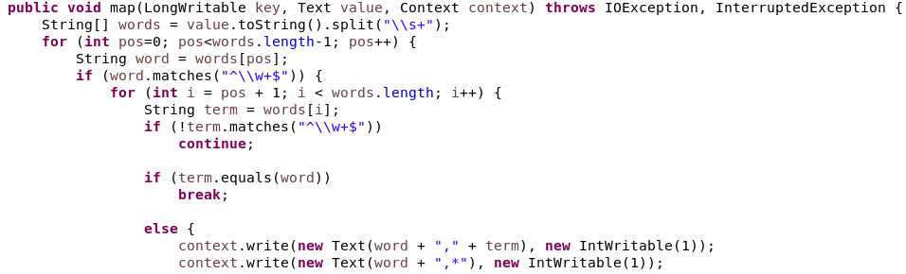
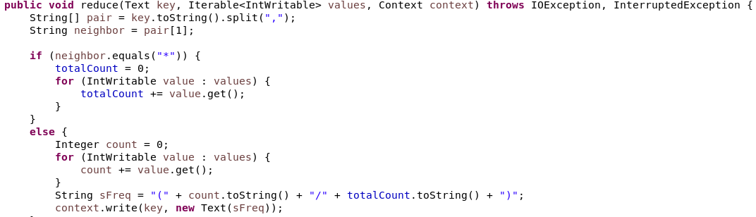
PAIRS JAVA CODE: Relative Frequency

Slide 4
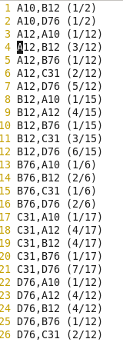
PAIRS RESULT: Relative Frequency

Slide 5
STRIPES PSEUDOCODE: Relative Frequency
Class Mapper Method map(docid a; doc d) For all term w in doc d do H = new AssociativeArray For all term u in Neighbors(w) do H{u} = H{u} + 1 Emit(term w; Stripe H)
Class Reducer Reduce (term w; stripes [H1;H2…]) Hf = new AssociativeArray() Count = =0 For all H in stripes [H1;H2;…] do Count += Sum(Hf; H) Hf = Hf / count Emit (w, Hf)

Slide 6
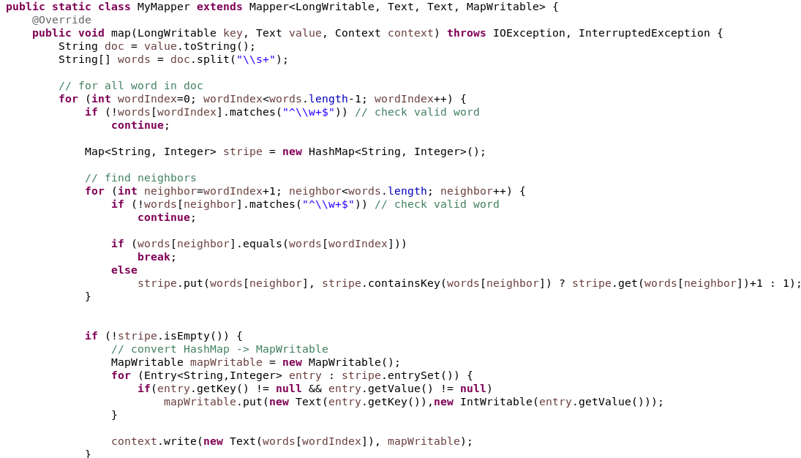
STRIPES JAVA: Relative Frequency

Slide 7
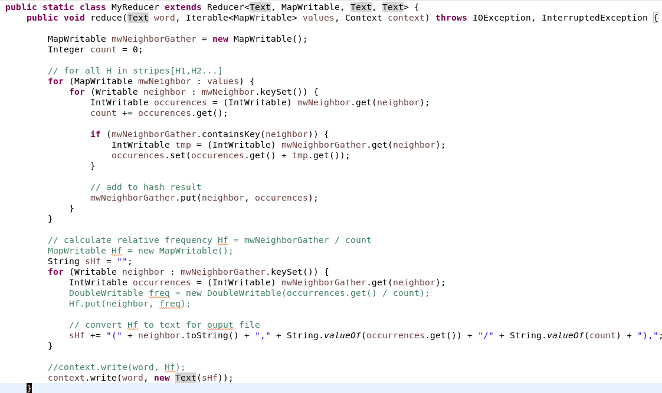
STRIPES JAVA: Relative Frequency

Slide 8
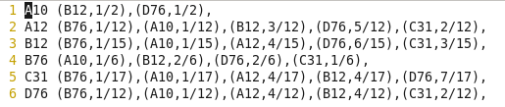
STRIPES RESULT: Relative Frequency

Slide 9
HYBRID PSEUDOCODE: Relative Frequency
Class Mapper Method Map (docid a; doc d) For all term w in doc d do For all term u in Neighbors(w) do Emit(pair(w;u); 1)
Class Reducer Initialize tprev = null total = 0 H = new AssociativeArray() Reduce (Pair (w;u), counts [c1;c2;…]) term = w if (term<>tprev && tprev <> null) Emit(term, H/total) total = 0 H = new AssocitativeArray() sum = sum[c1;c2;…] tprev = term H{u} = sum total += sum Close Emit(tprev, H/total)

Slide 10
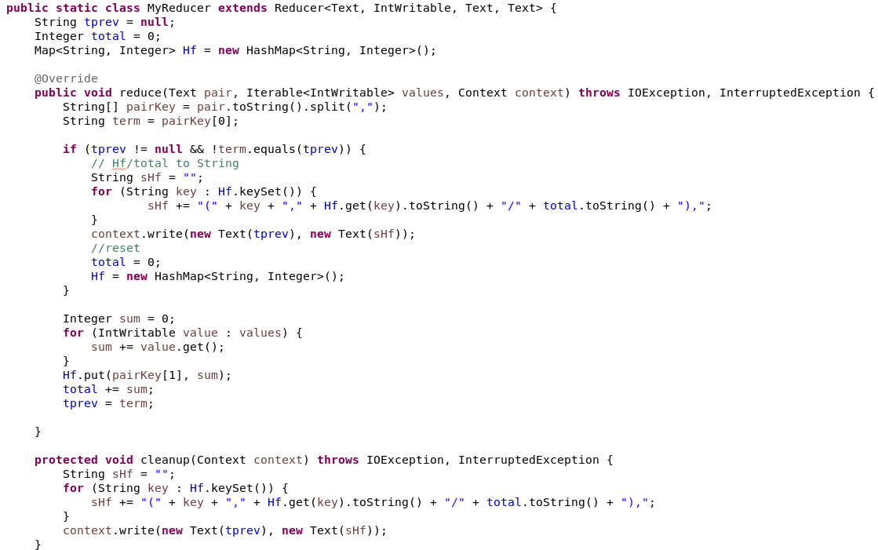
HYBRID JAVA: Relative Frequency
Mapper is the same Pairs approach, only remove “Emit((w;*), count 1)”

Slide 11
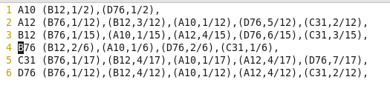
HYBRID RESULT: Relative Frequency

Slide 12
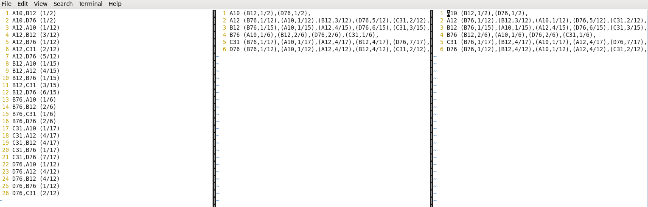
PAIRS vs STRIPES vs HYBRID
Execution Time: + Spairs: 33.826 seconds + Stripes: 29.592 seconds + Hybrid: 30.847 seconds

Slide 13
SPARK PROJECT: APACHE LOG ANALYZING
Log Statistics
Response Code: Error and Normal
IP Clients have access times more than 10
Top 3 IP Clients access to Website
Top 10 accessed Web content
Average Size of accessed Web content

